Slide 1
US Property Value Analysis
Summya, Lipika, Priya, Yash, Ithamar
Notes:
Lipika

Slide 2
Motivation & Summary
Overall Goal:
Our aim is to discover how outside factors affect the average property value over different states between 2010 - 2020
Summary:
Taking natural disaster,property tax and demand score data to observe any relationship to property values
Notes:
Speaker: Lipika

Slide 3
Hypothesis:
If a state has more natural disasters in a particular year, then the average property value, property tax and demand for property in that area for that year will be lower compared to other years.
Notes:
Speaker: Summya

Slide 4
Questions
Data Sources
What are the average property values in the US?
What are the natural disaster patterns in the US?
How are natural disaster patterns related to US property value ?
What are the average property values in the US by house type?
What is the relationship between demand of a location and property tax?
What is the correlation between property tax and property value ?
Kaggle
Zillow Housing
NJ State Department
Realtors
Notes:
Yash

Slide 5
Data Cleanup & Exploration
Exploration
Aim was to find data that covered all US states between 2010-2020
Conclusion from findings:
Noticed tables are labeled differently within same data sources
Difficult to find consistency of organization (zip code, FIPS,major city)
Large files dating very far back
Granular - organized to county level
Goal for Data Clean Up
Organize files so they all have consistent data
Shortcomings?
Data included all 50 states , years of each data set varied, various files needed to merge (property tax) so not able to retrieve all data sets
Notes:
Priya
The Kaggle data base which had a csv on Natural Disasters in the US from 1953 - 2017. Data broken out monthly as well by county level.
The Zillow database has data from 1996 to current, month on month
Property tax data had inconsistency over the column names and sheet format

Slide 6
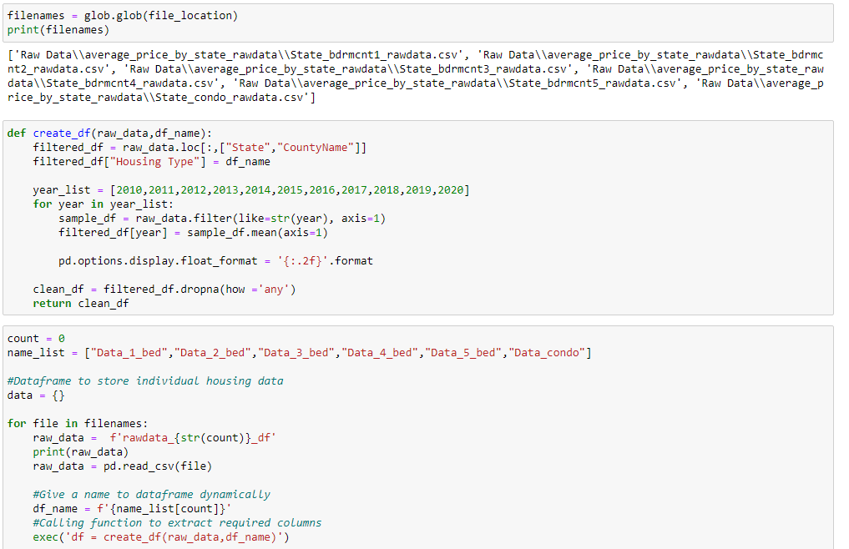
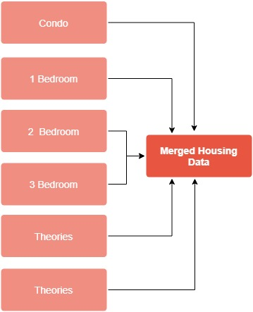
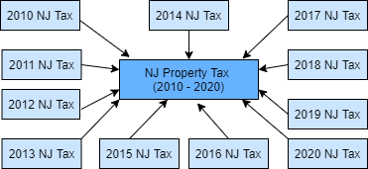
Data Clean Up
Notes:
Priya

Slide 7
Visualizations

Slide 8
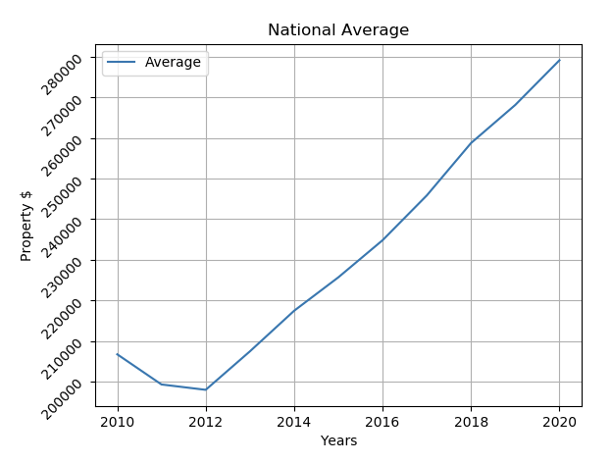
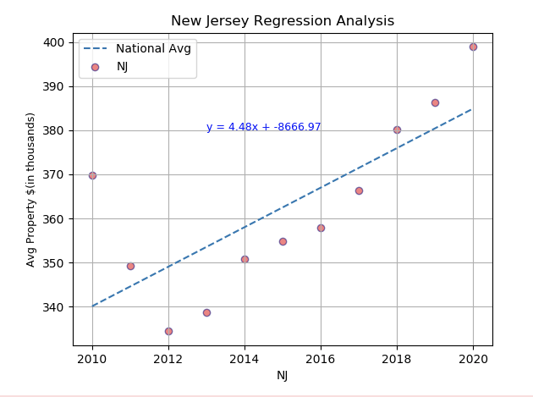
What are the Average Property Values in the US?
Notes:
yash

Slide 9
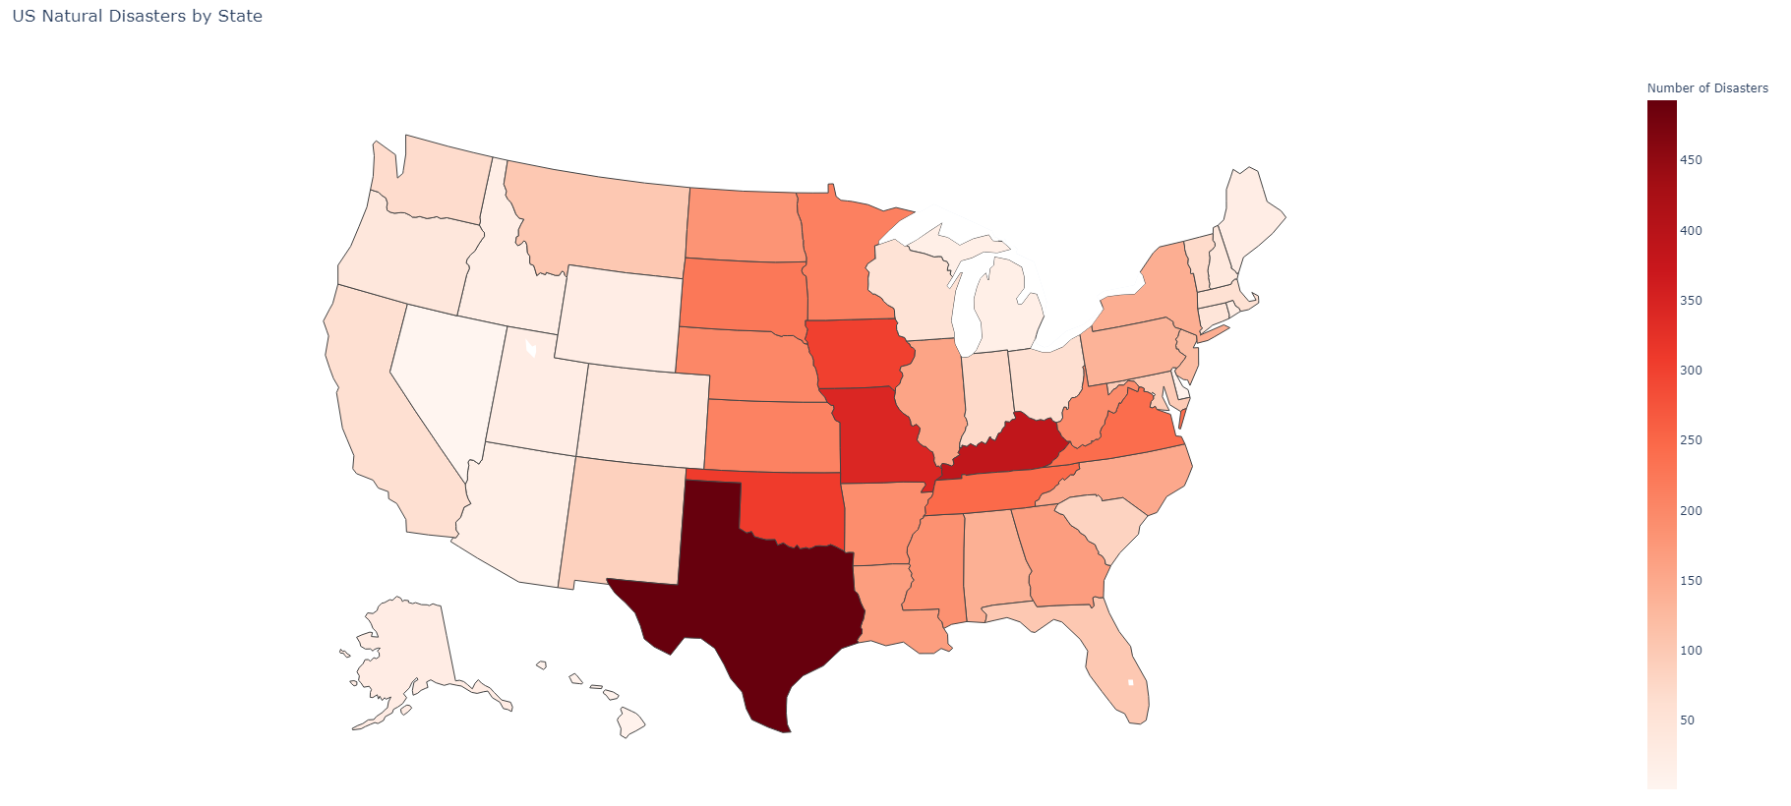
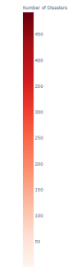
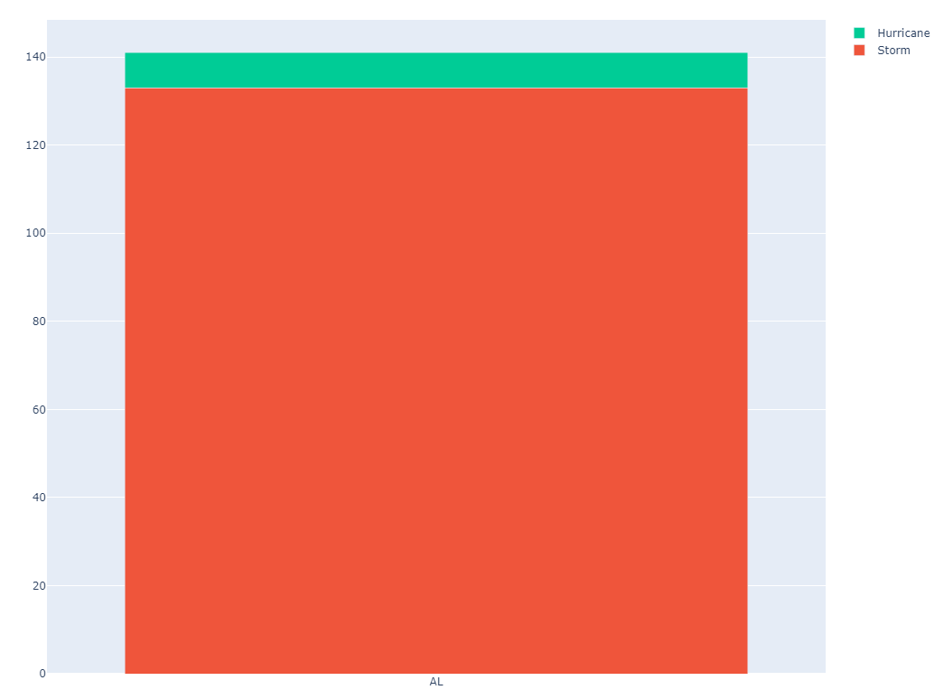
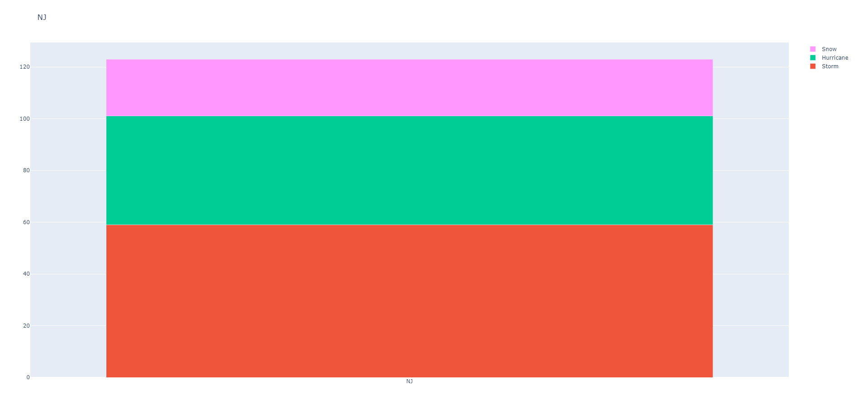
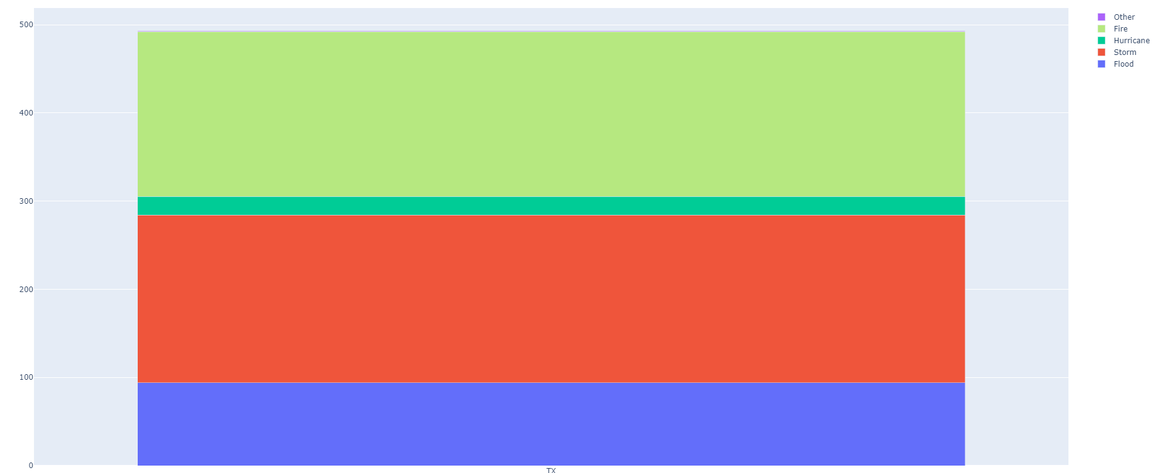
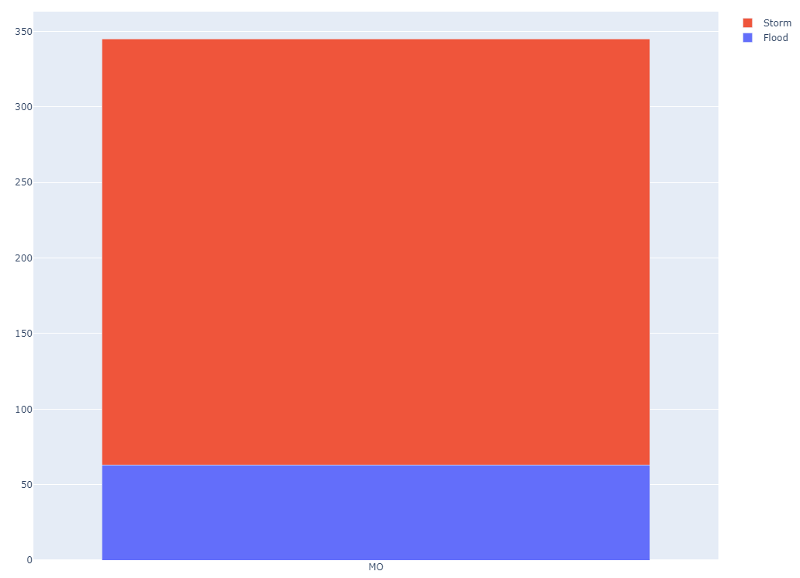
What are the Natural Disaster Patterns in the US?
US Natural Disasters By State
NJ
AL
TX
MO
Top 5 States | Bottom 5 States
TX 493 KY 387 MO 345 OK 309 IA 302 | RI 25 UT 24 ME 24 WY 23 ID 21
Notes:
lipi

Slide 10
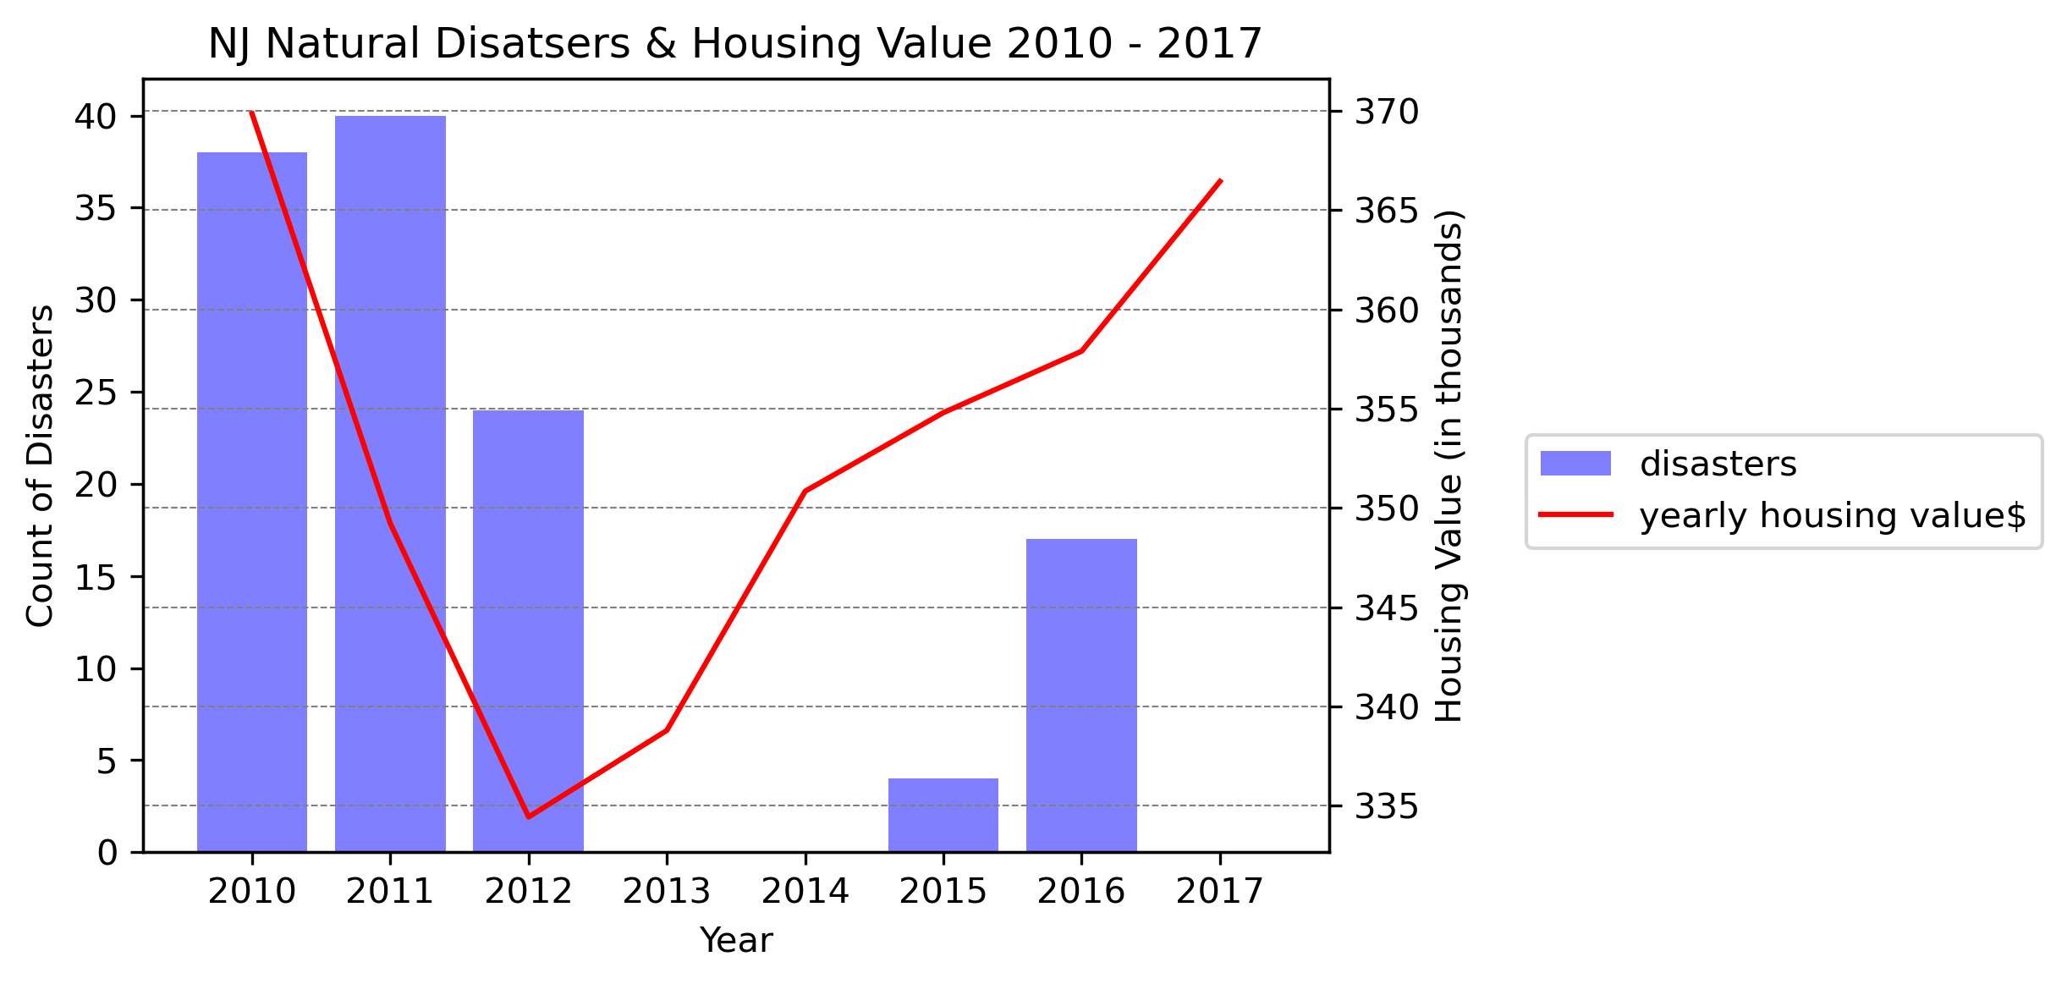
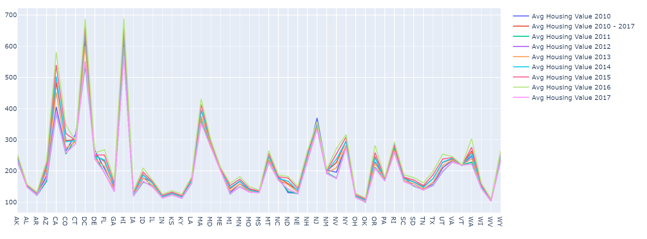
How are the Disaster Patterns Related to US Property Value?
Regardless of disaster pattern - states exhibited upward sloping trendline for their housing values from 2010 - 2017
Noticed a dip in 2012 (recession)
Plotted average housing value for each year and concluded that 28 states hit the lowest point in 2012
Average Housing Value per State 2010-2017
Notes:
summya

Slide 11
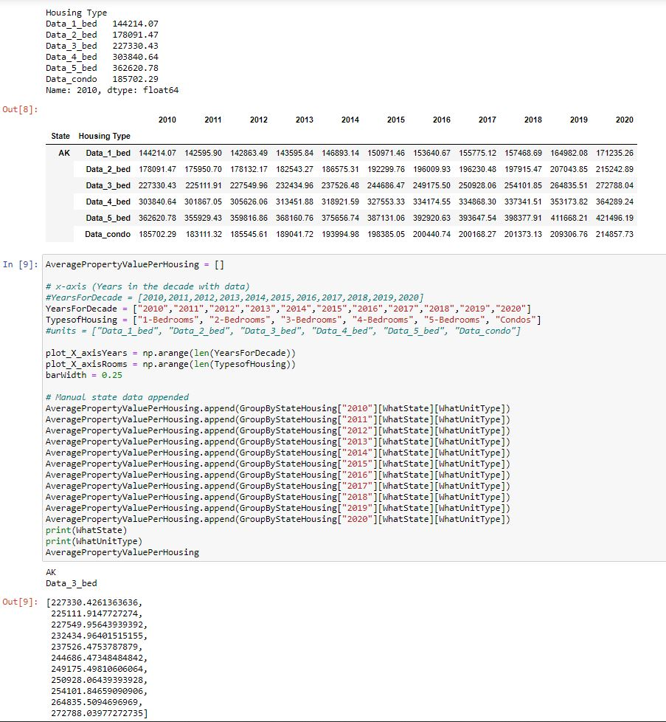
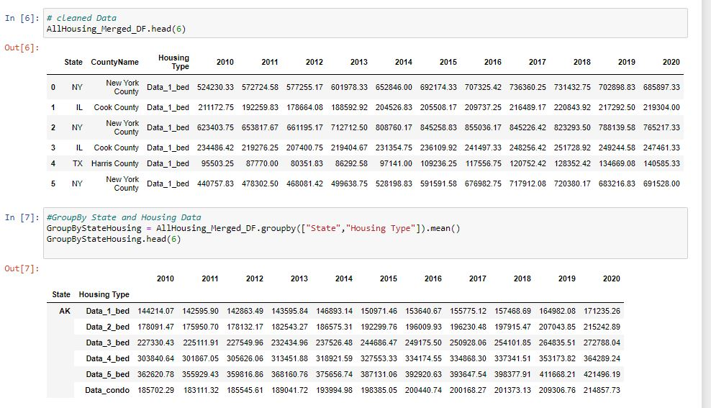
Can ‘type of housing’ (and its AVP) tell us Anything or give any more insights on if natural disasters affecting property values?
Notes:
ithamar

Slide 12
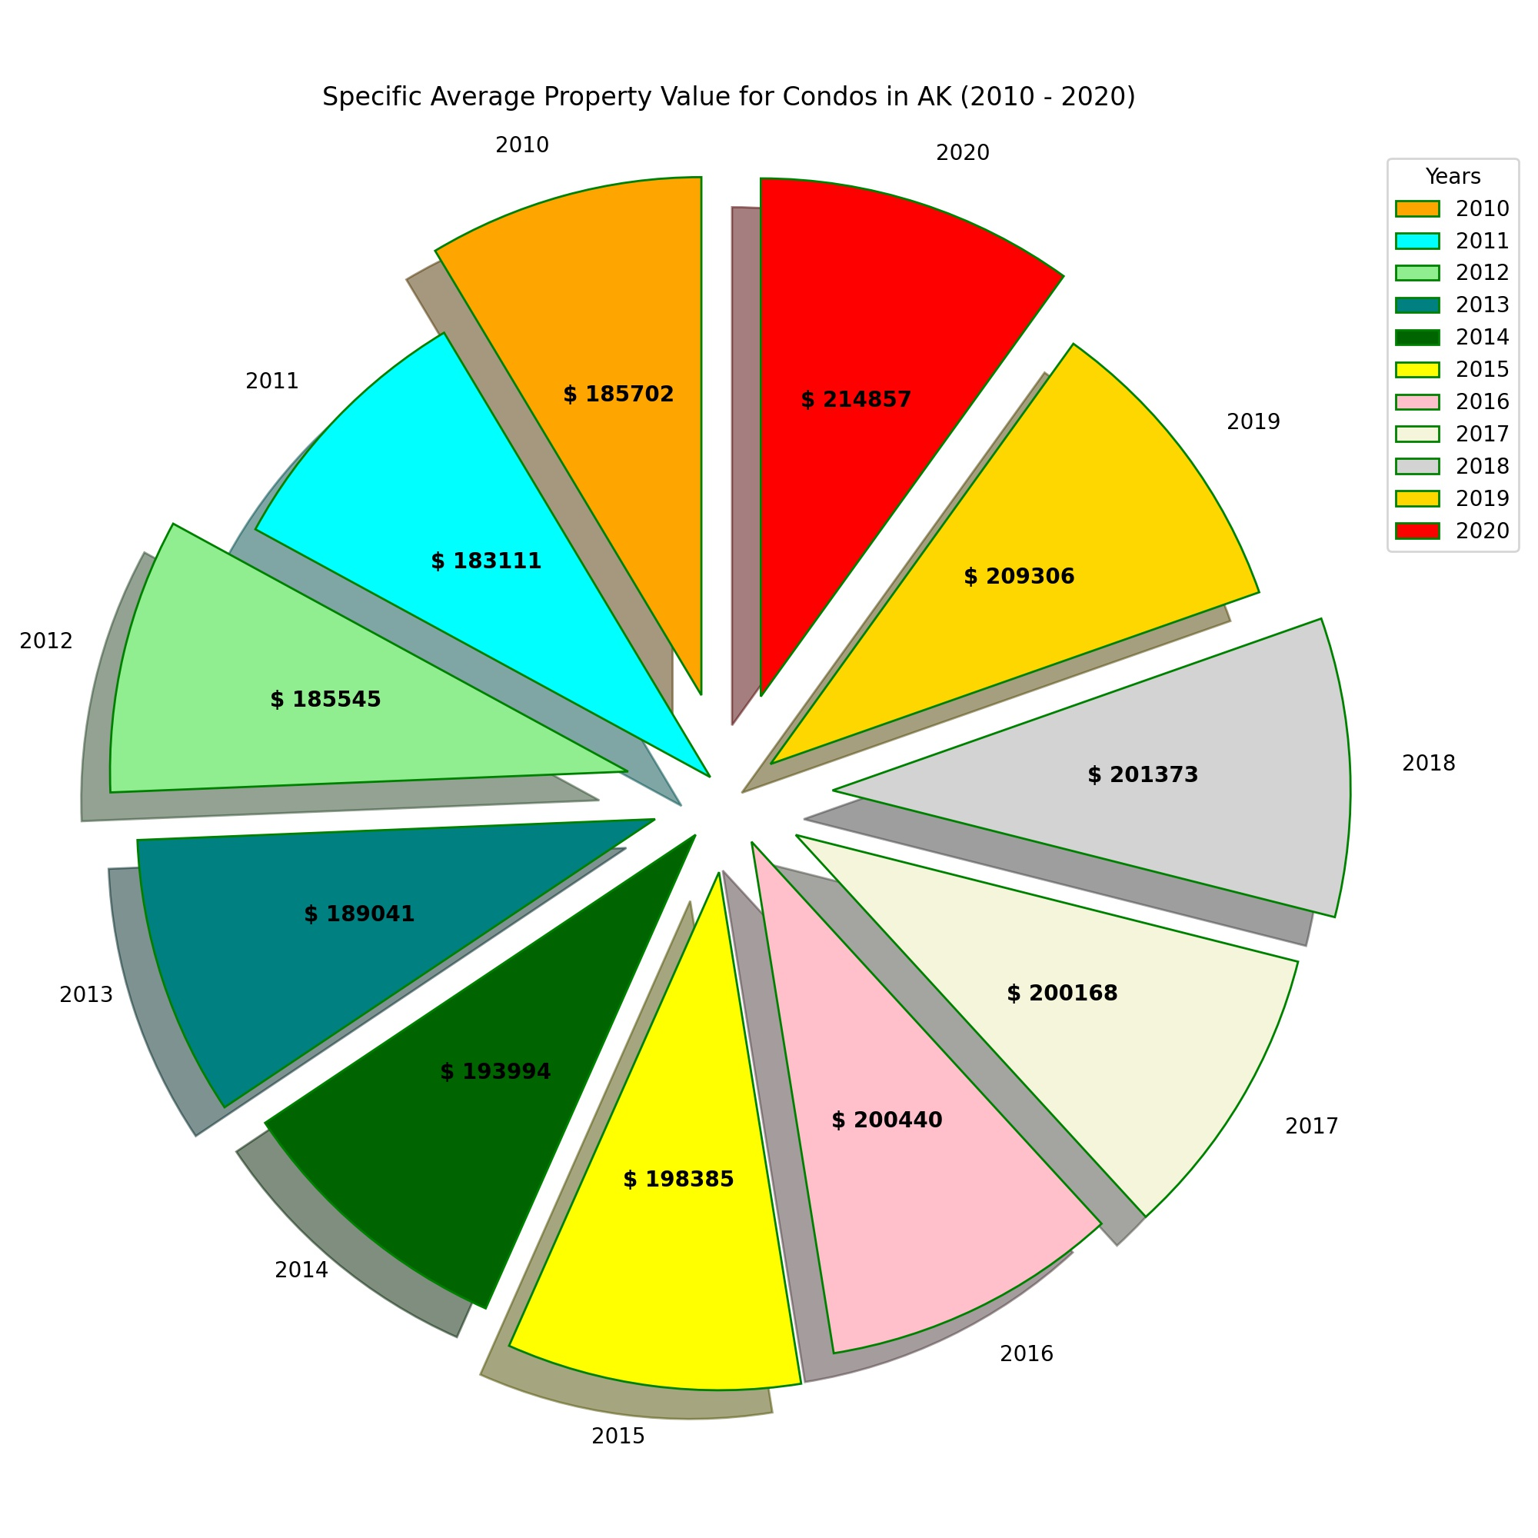

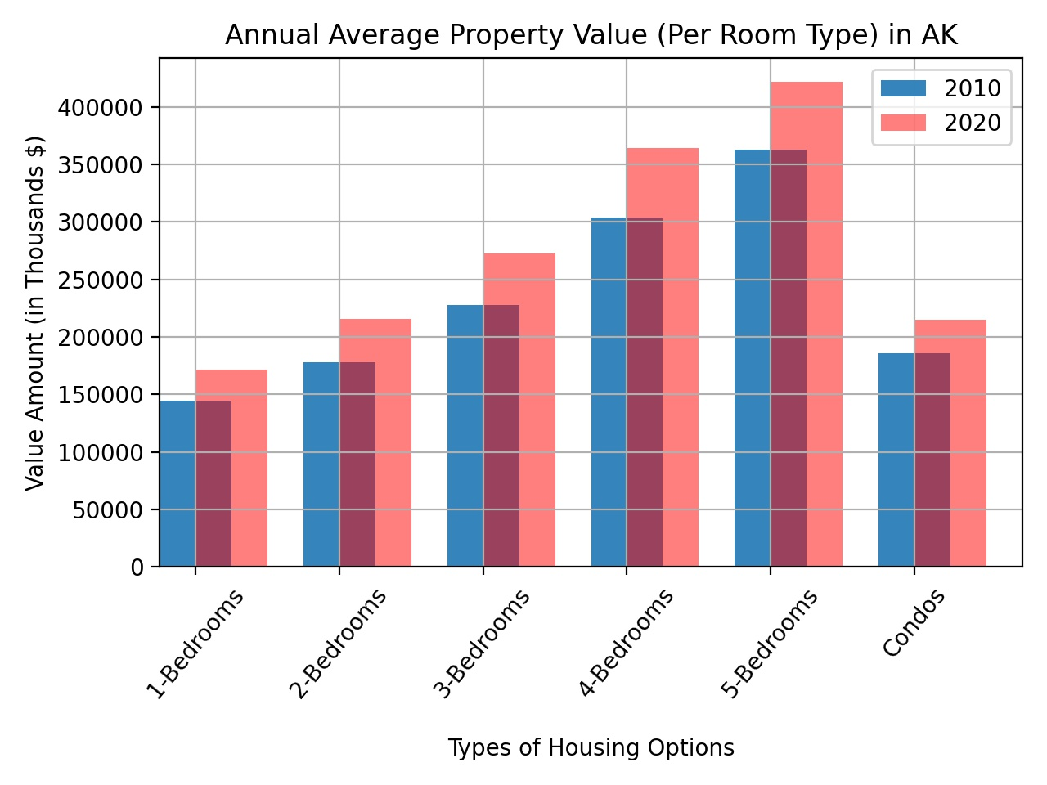
Can type of housing tell us anything of relevance or more insight on housing trends
Notes:
ithamar

Slide 13

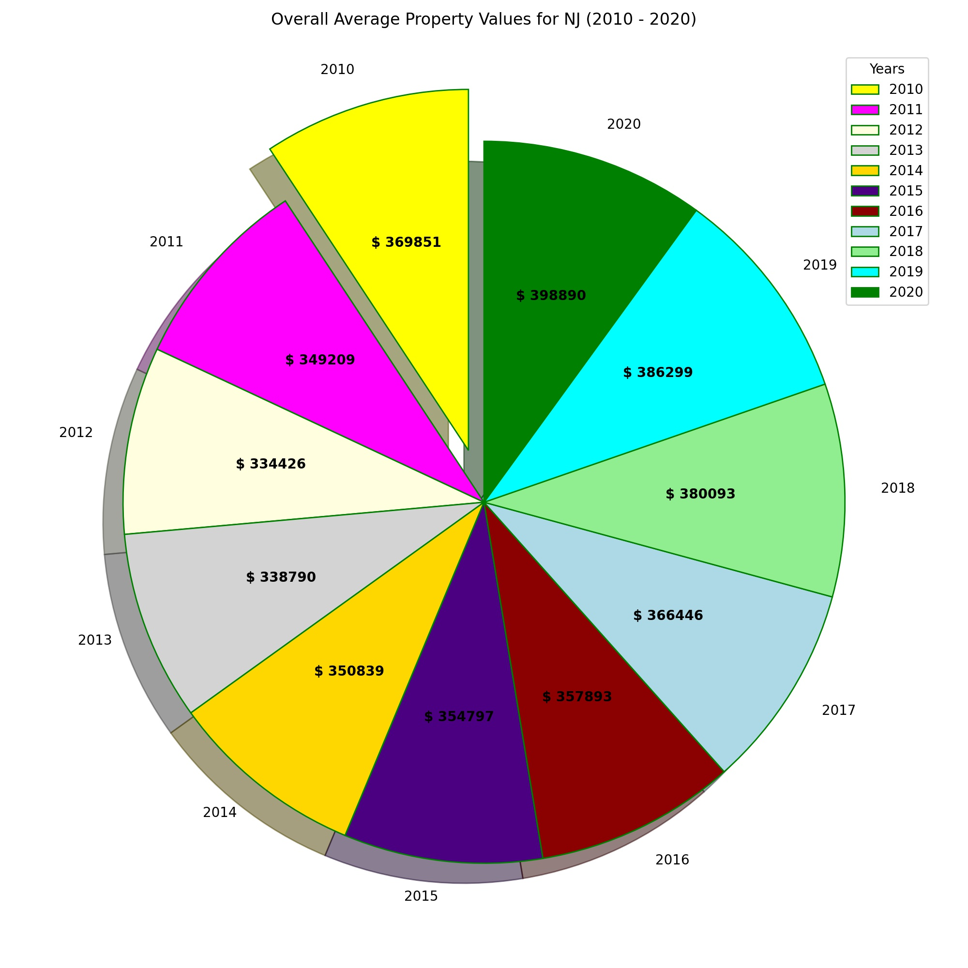
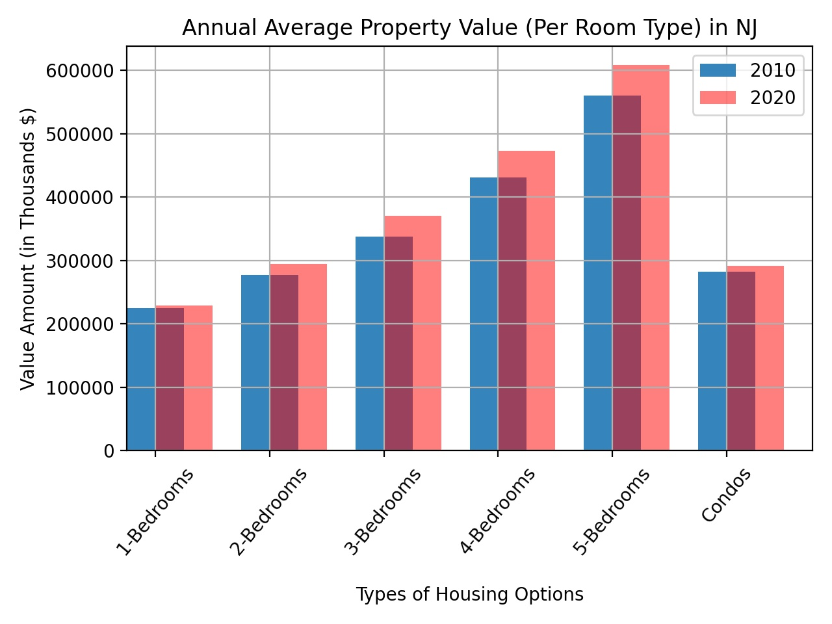
Notes:
ithamar

Slide 14
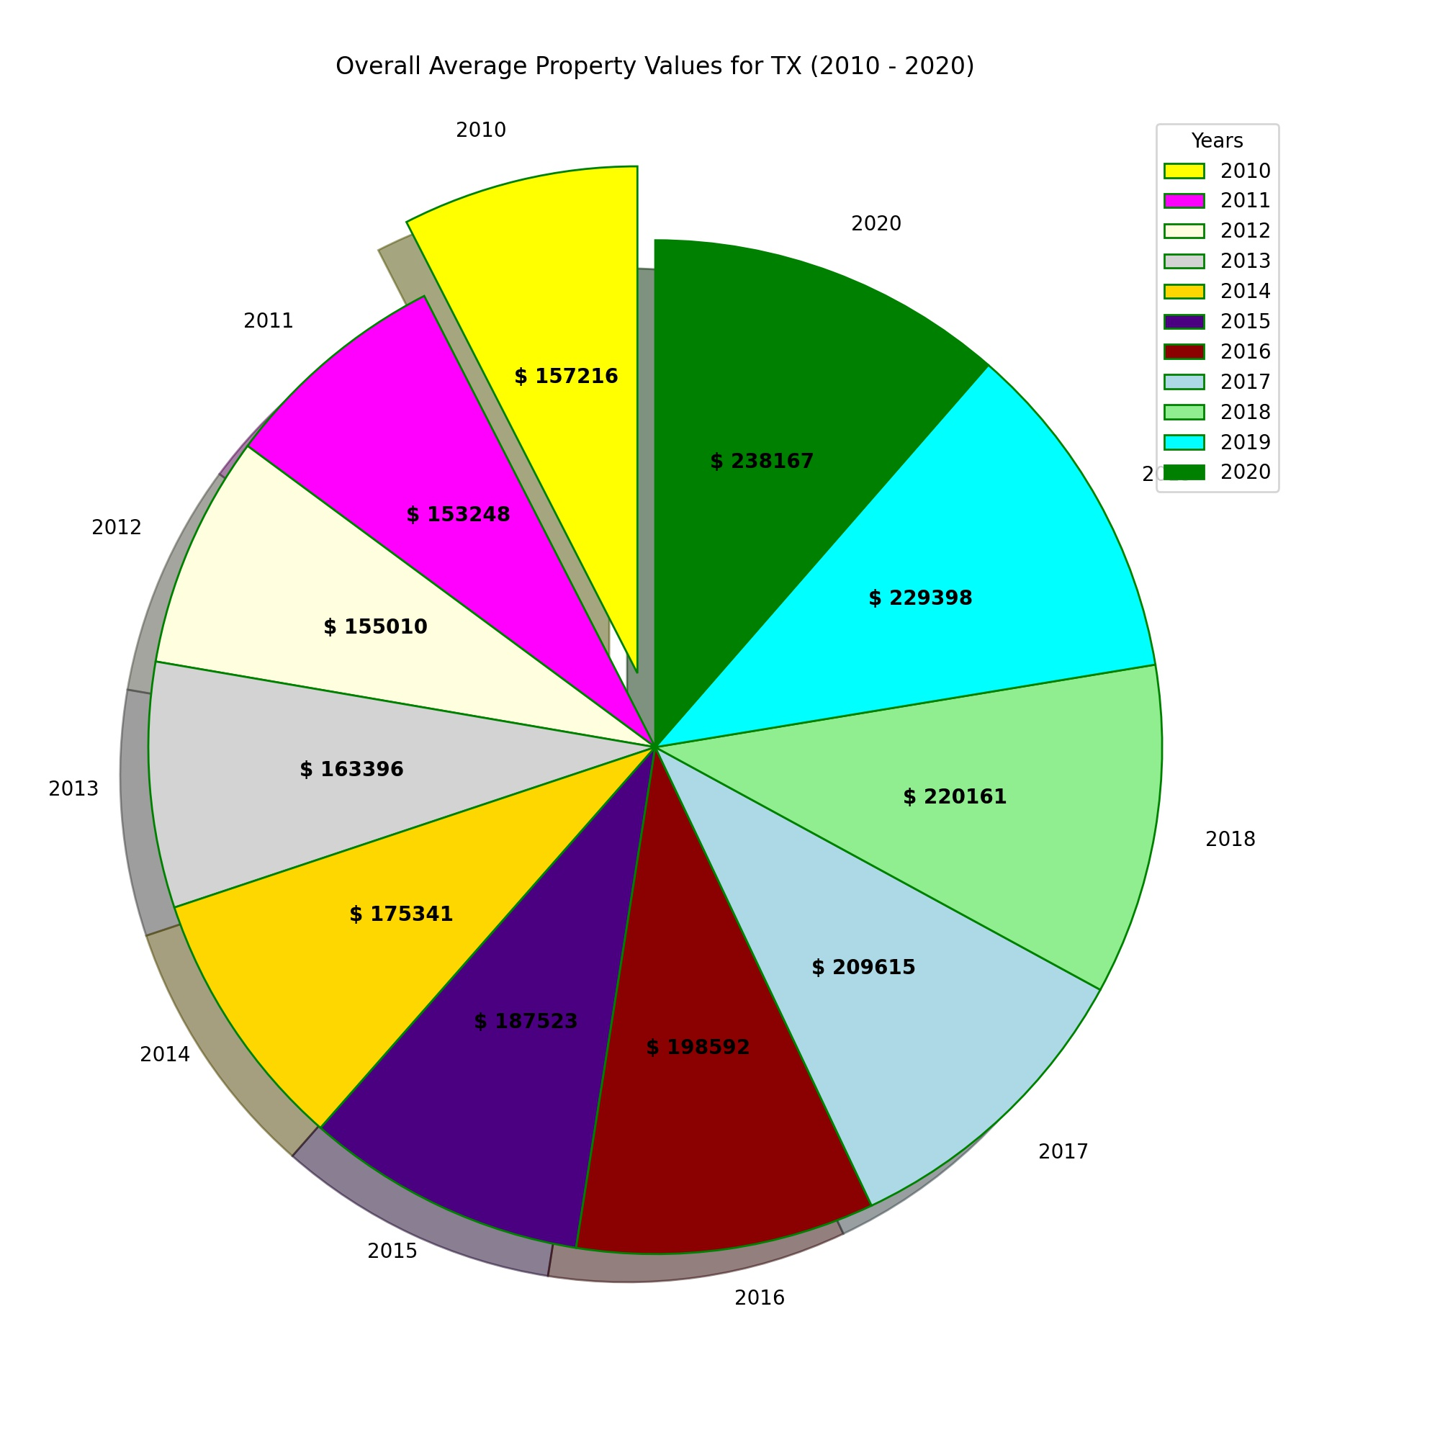
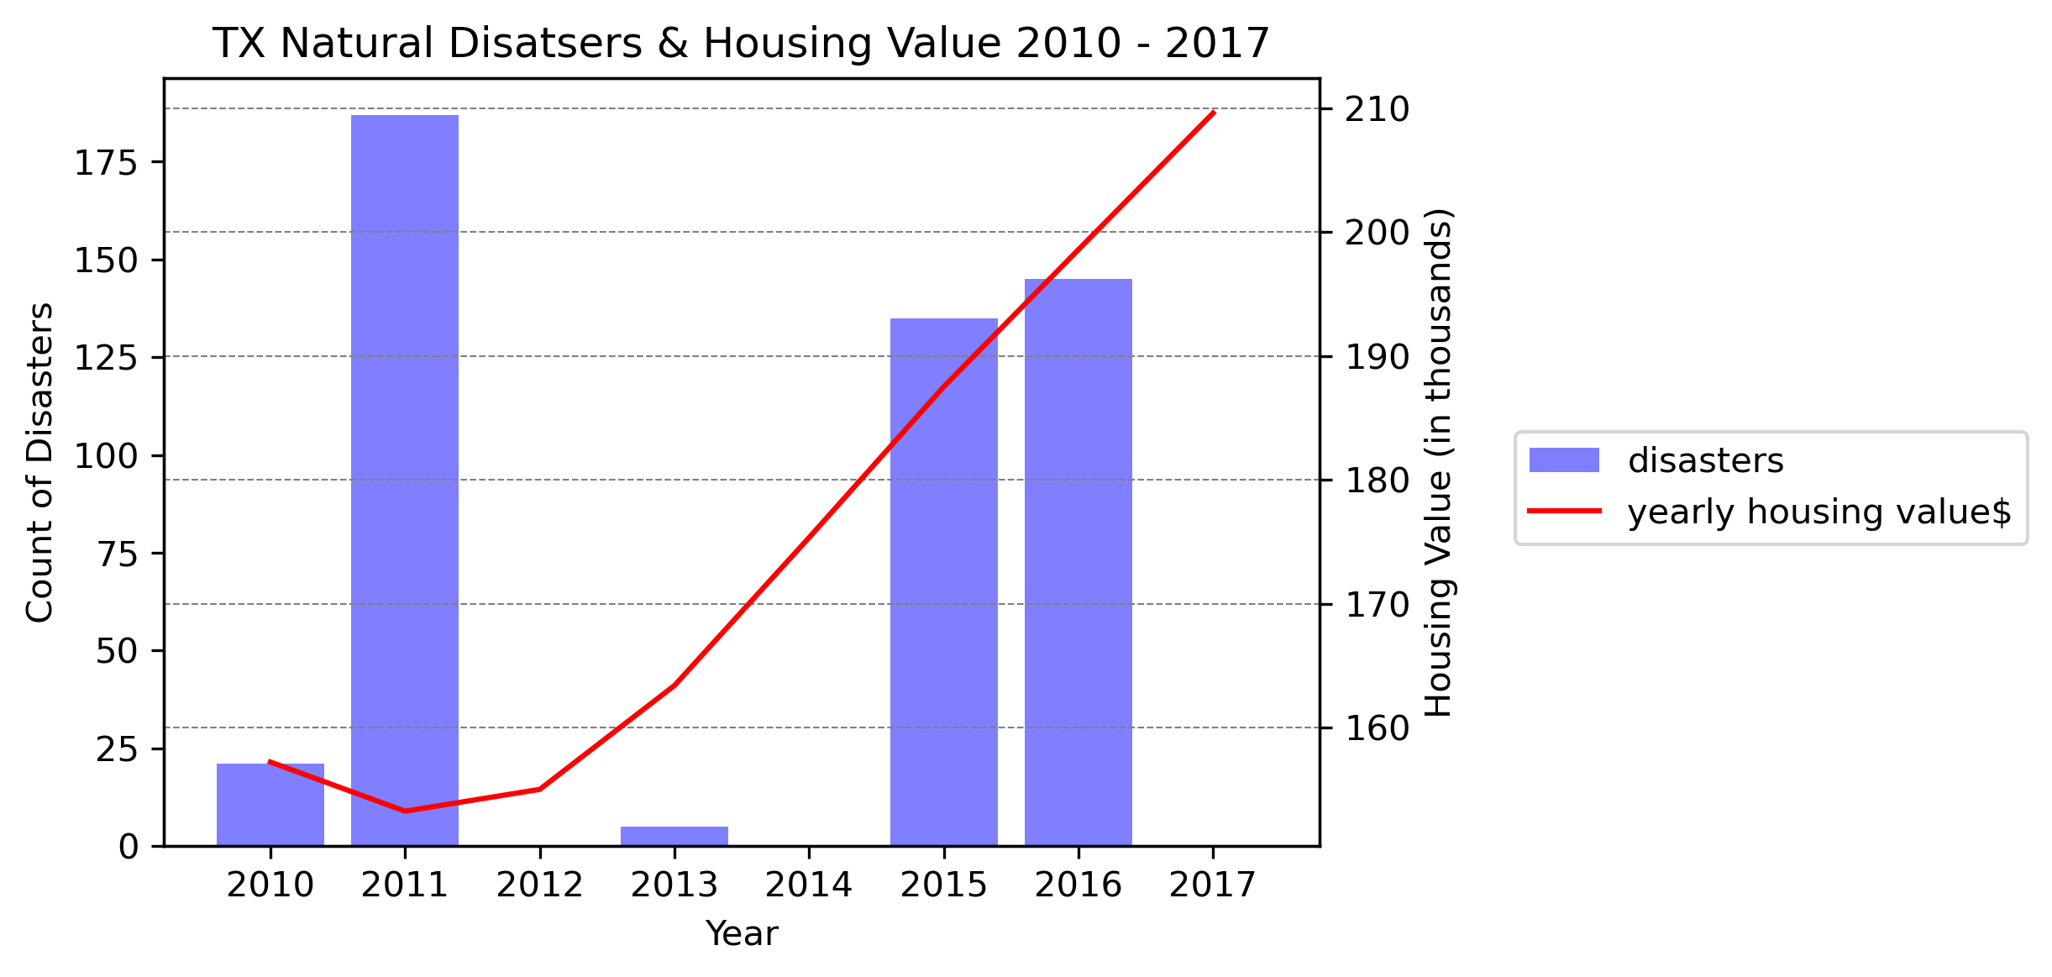
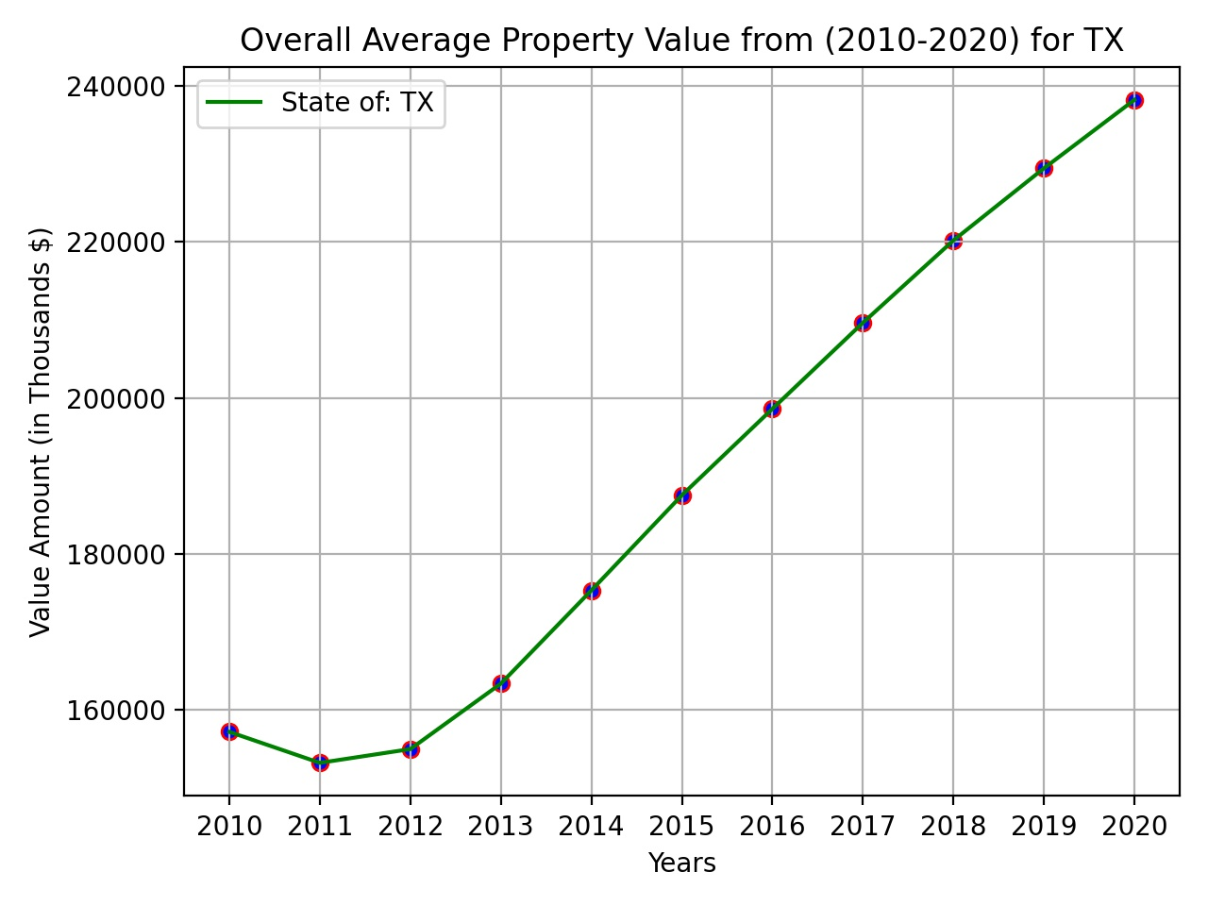
Notes:
ithamar

Slide 15
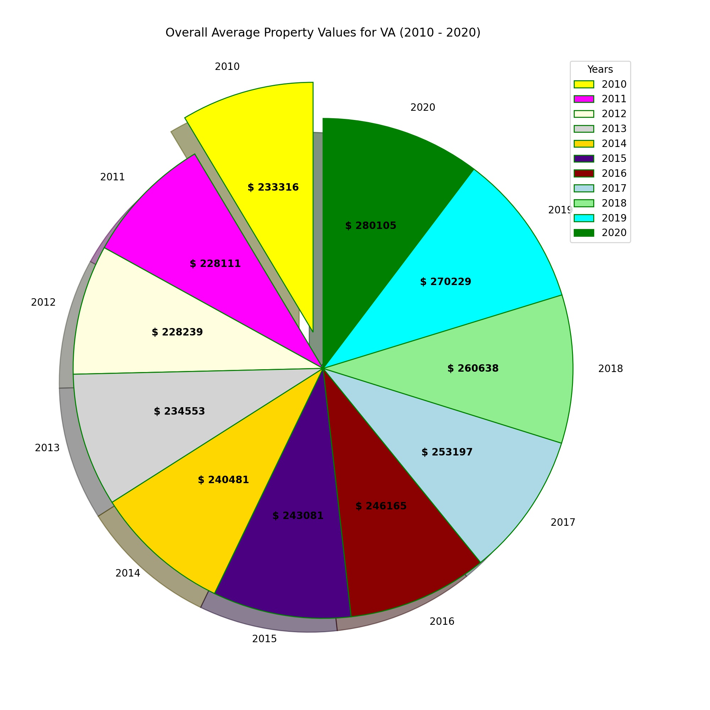
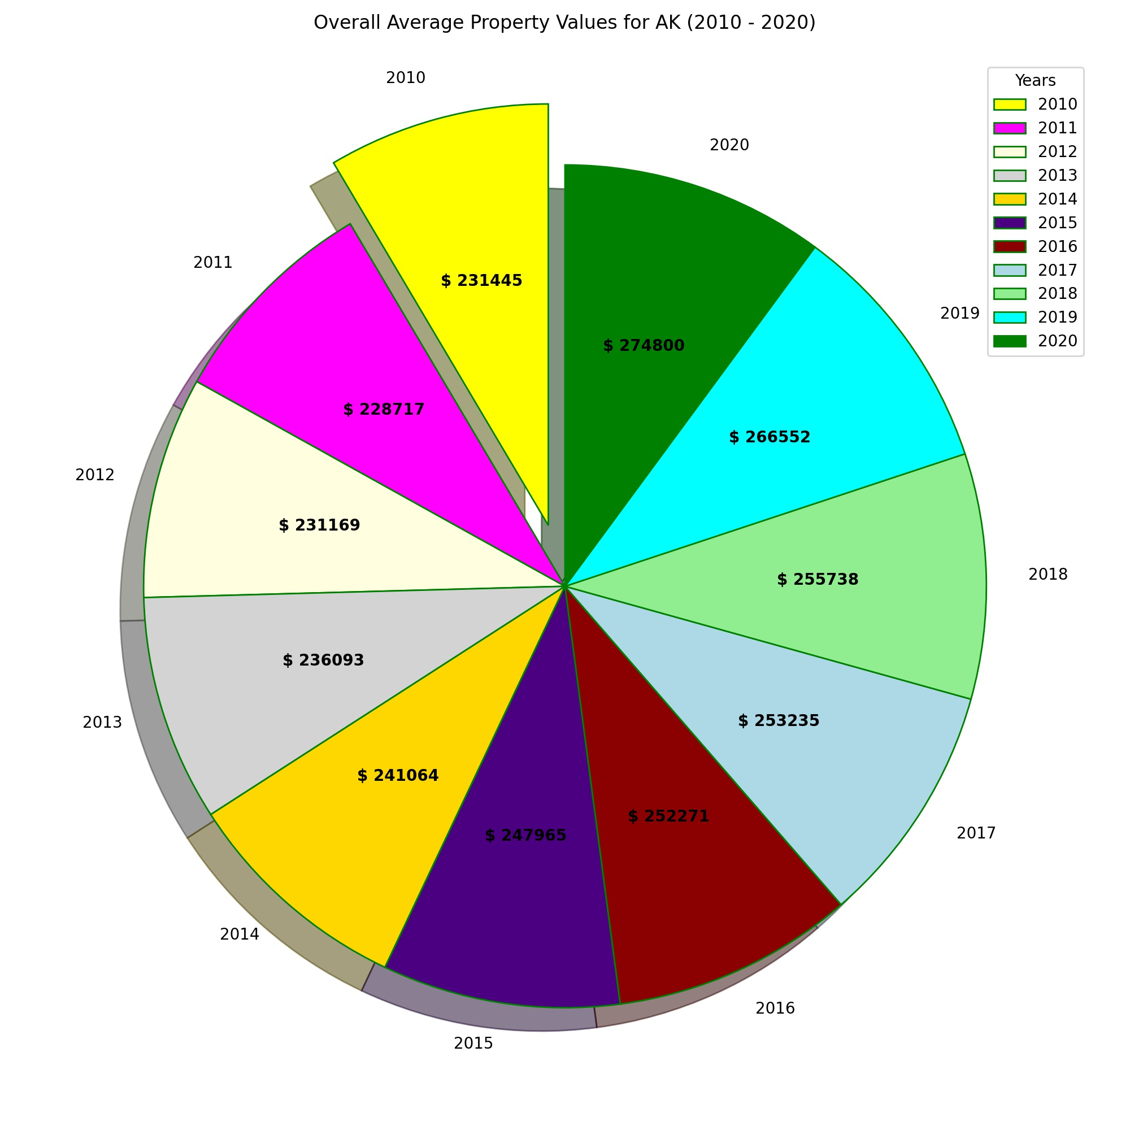
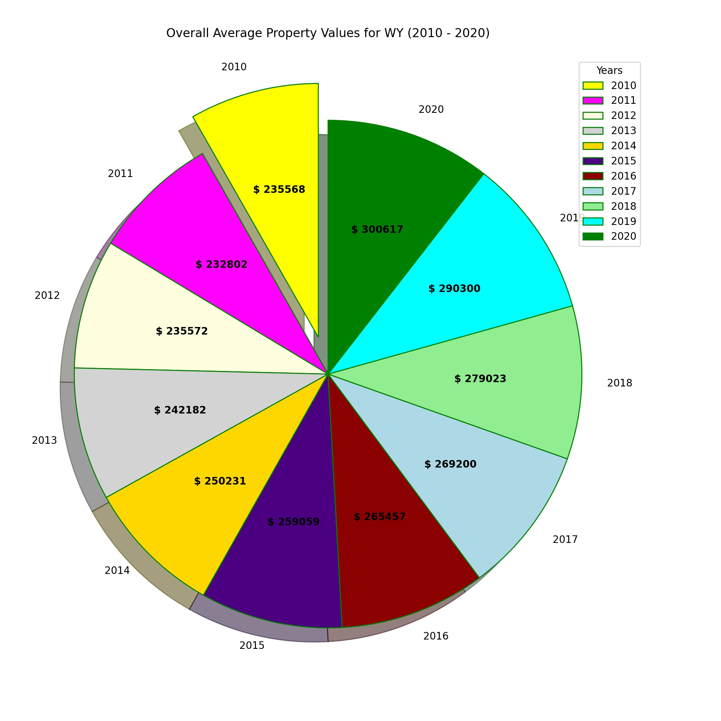
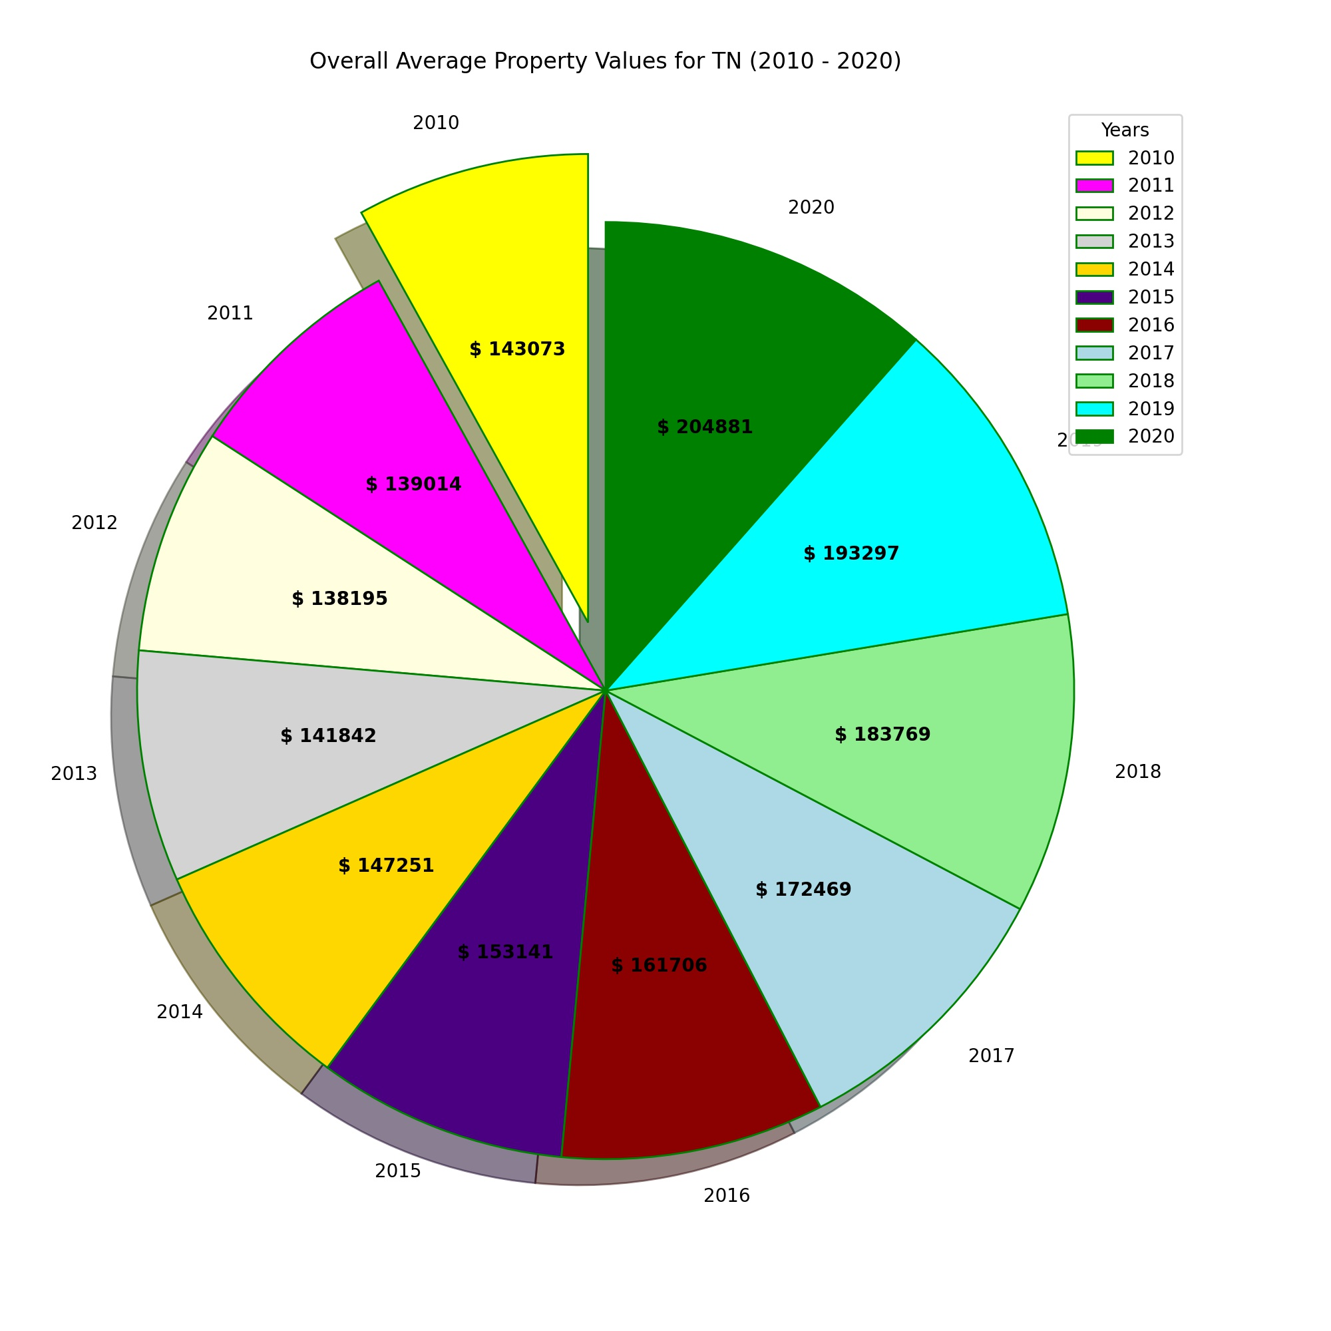
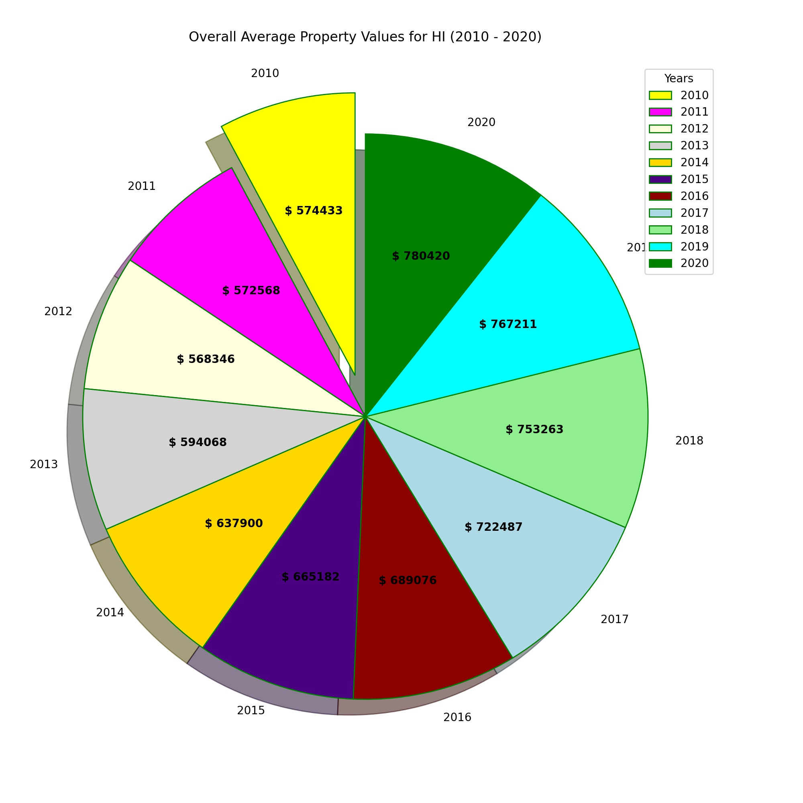
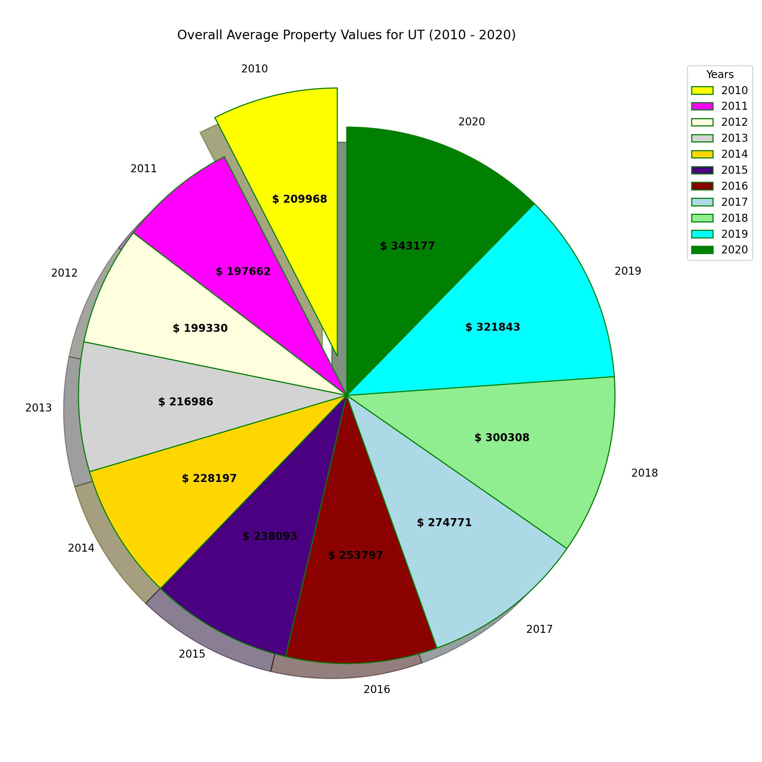
Notes:
ithamar

Slide 16
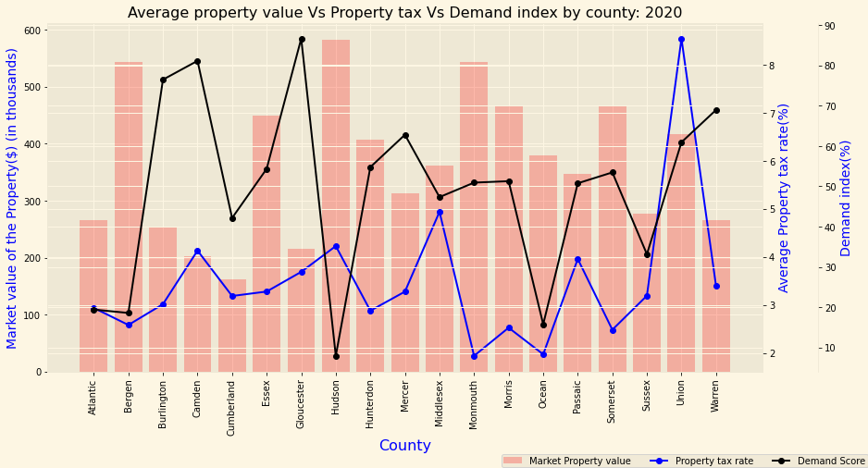
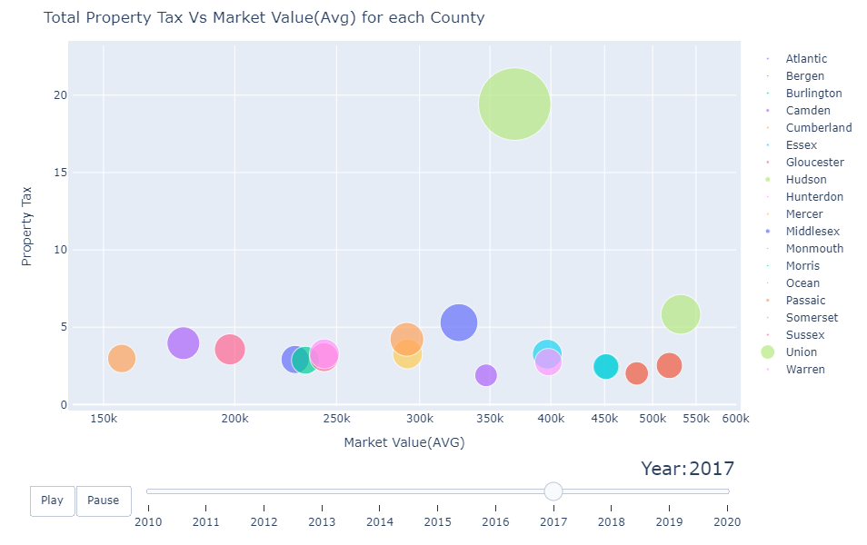
What is the Relationship Between Demand Score,Property Tax and market value of property?
Average market value of the house and property tax are not mutually dependent on each other
Property tax rate is calculated based on the assessed value of the property and the township’s requirement
However, the property tax also influences the trend of searching for house [demand score]
Gloucester county ranks 27th place in US & 1st place in NJ, with demand score of 93% for year 2020
Notes:
Priya

Slide 17
Conclusions
Reject our hypothesis
Property Values show no direct correlation with Natural Disasters and Property Tax
Demand Score does have a correlation with Property Value. Higher Property Values have Lower Demand Scores
Notes:
Summya

